Slide 1
DCF (FCFE) valuation of ITC LTD

Slide 2
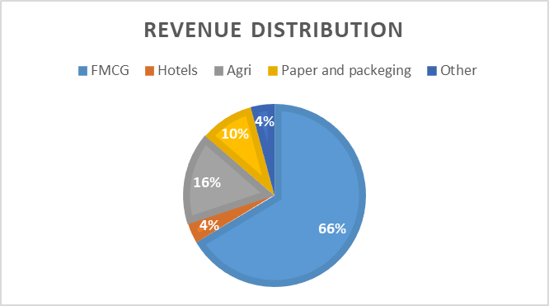
ITC LTD:
Established in 1910, ITC is the largest cigarette manufacturer and seller in the country.
ITC operates in five business segments at present — FMCG Cigarettes, FMCG Others, Hotels, Paperboards, Paper and Packaging, and Agri Business.
The company has delivered sales growth of 7.96% over past five years.
Share value = Rs. 429
Market capitalization = Rs. 561300 Cr

Slide 3
Inputs for the valuation:
Formulas:
Risk free rate =
(1+US risk free rate)*(1+India inflation rate) -1
(1+US inflation rate)
Equity risk premium = US equity risk premium+ India CDS spread

Slide 4
Levered beta =
Beta * (1+ (1-tax rate)*Debt)
Equity
Marginal tax rate = 24%
Perpetual growth rate = Risk free rate
Cost of equity = Risk free rate+ levered beta*equity risk premium

Slide 5
Free cash flow to equity(FCFE):
All values in crores

Slide 6
According to DCF valuation the value of ITC share is Rs. 233.28
All values in crores

Slide 7
References:
Most of the concepts has been taken from Aswath Damodaran valuation class.
The risk free rate, equity risk premium, Corporate tax rate has been taken from NYUstern website (Aswath Damodaran)
The growth rate has been taken from yahoo finance.
Marginal tax rate has been taken from screener website.
Equity and number of share outstanding has been taken from Prabhudas Liladhar equity research report.
Financial inputs has taken from ITC financial report (official website).

